Slide 1
IHE’s Plug-a-thon Dispels New Health Technology Hype vs Value

Slide 2

IHE’s Plug-a-thon Dispels New Health Technology Hype vs Value
John T. Donnelly, President, IntePro Solutions Inc (moderator)
Samir Jain, VP of Technology, Ready Computing
John Novak, Snr Director Architecture & Gov’t Technologies,
Healthcare Delivery Systems iLab, NJ Innovation Institute

Slide 3








Plug-a-thon is a hybrid, dynamic event
Educate
Mix of education, discussion and early trial exploration
Sessions for both singular and cross-track discussion
Problems, aka use cases, to be addressed introduced by participants & sponsors
New stakeholder partnerships are an expected take-away
Secondary outcome…inform the Health IT standards development pipeline
IHE
Plug-a-thon
Evaluate
Discuss
Code/Connect

Slide 4

Plug-a-thon… Jan 2018
Plug-a-thon tracks designed to explore:
  Problems or use cases in healthcare that can be addressed with the specific technology AND how the technologies can inter-relate
  How existing standards offerings and non-healthcare industry activities that use this technology could be leveraged
  Potential touchpoints with existing IHE profiles e.g. FHIR® based profiles
Four Plug-a-thon tracks included at the 2018 event
  mHealth
  Devices on FHIR®©
  Internet of Things - Medical
  Blockchain - Healthcare

Slide 5
Plug-a-thon…Jan 2018
mHealth Track
  Exploration to connect the new, prolific generation of health IT participant; the smartphone app and internet cloud product developer, with the current keepers of healthcare data; the health systems, integrated delivery networks (IDNs), and Health Information Exchanges
Devices on FHIR®© Track
  Leveraged HL7 FHIR to exchange health device information: on-demand, real-time, granular. RESTful technology can simplify utilization of this content in knowledge-driven applications such as clinical decision support, care coordination, precision medicine and analytics (population health & predictive).

Slide 6
Plug-a-thon…Jan 2018
Internet of Things - Medical Track
  Explored the new tier of connectivity grounded in the growing number of consumer-focused sensors/wearables, and facility / resource management solutions, as well as medical technology that leverage pervasive sensor networks and control systems
Blockchain Track
  Explored and learnt about this new type of trusted connectivity solution that is the technology underpinning the bitcoin phenomenon for creating continuous streams of healthcare information across the financial, clinical and administrative elements of the medical ecosystem.

Slide 7
Plug-a-thon…Jan 2018
Some Observations and Results
  Plug-a-thon validated as the first pillar of the Health IT Testing Continuum
  Blockchain, ”the new kid on the block”, garnered cross-track attention as participants explored touch points with other new and existing technologies
  The Internet of Things and mHealth Health IT realms are finding common target markets as sensors and smartphone apps create singular solutions for consumers
  Person identity administration remains a core underpinning and challenge for integration of new and existing care paradigms
  Healthcare is poised for a “New Economy” of patient-provider-payer transactions

Slide 8
IHE USA Plug-a-thon 2018 Sponsors
Healthcare Systems Delivery iLab, New Jersey Innovation Institute
Ready Computing, Inc

Slide 9
IHE USA Plug-a-thon 2018
Sponsor: NJ Innovation Institute

Slide 10

New Jersey Innovation Institute
A wholly owned not for profit division of the New Jersey Institute of Technology
State Designated Entity for Health IT Interoperability
Manager of the New Jersey Health Information Network (NJHIN)
CMS Certified Data Registry (300+ measures)

Slide 11
NJII Healthcare Delivery System i-Lab
Track Record of Success
  2010 – 2015: $23 Million - Regional Extension Center, formerly NJ-HITEC (9,000+ Physician and Specialist Network)
  #1 recognized in the country
  2010 – Present: Health Information Exchange, Highlander Health Data Network
  5-hospital healthcare data exchange network
  2011 – Present: CMS Certified Data Registry
  300+ Measures covering over 40 specialties for over 4,500 providers
  2012 – Present: Population Health Service Provider
  Serving 17 DSRIP Hospitals, 5 ACOs, and 500,000 lives
  2015 – 2017: $5 Million - NJII as State-Designated Entity for Health IT: New Jersey Health Information Network Pilot: Statewide ADT Notification Service. NJ Master Person Index (MPI), State Registry Gateway for Immunizations.
  2015 – 2019: $50 Million - CMS Practice Transformation Network Awardee: Garden Practice Transformation Network
  Transform 11,500 providers to achieve performance targets and MIPS / APM scoring and preparedness
  2016 – 2018: $1.5 Million - Medicaid IAPD
  Onboard and Implement TOC for Medicaid Providers onto existing HIEs for the achievement of Meaningful Use
  2017 – 2019: $20 Million – Medicaid Expansion IAPD
  Expanding HIE adoption and NJHIN interoperability in NJ

Slide 12
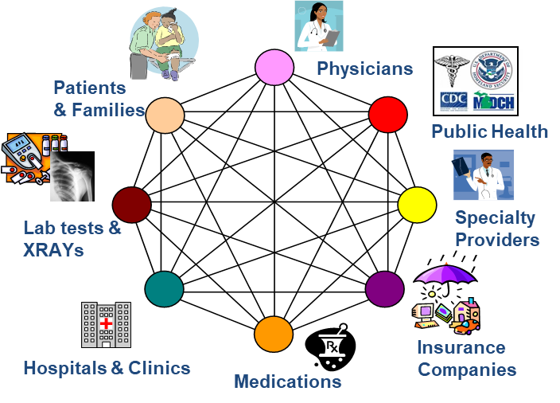
The New Jersey Ecosystem:
Over 70 Hospitals
14,801 Primary Care Physicians
14,745 Specialists
Six recognized Health Information Exchanges (HIE)
  Several new HIEs expanding into the market
  Five large health systems with HIE capabilities
NJ has the largest population of 1-2 provider practices

Slide 13

Value of the Plug-a-thon…
Plug-a-thon tracks designed to explore:
  Problems or use cases in healthcare that can be addressed with the specific technology AND how the technologies can inter-relate
Problems and Use Cases
  Transitions of Care
  Quality Reporting
  Public Health
  Smart Alerting
  Patient Identity

Slide 14
Value of the Plug-a-thon…
Plug-a-thon tracks designed to explore:
  How existing standards offerings and non-healthcare industry activities that use this technology could be leveraged
Existing Technologies
  Open API
  Apps (banking/retail/social/consumer)

Slide 15
Value of the Plug-a-thon…
Plug-a-thon tracks designed to explore:
  Potential touchpoints with existing Standards IHE/HL7/FHIR®
We have plenty of standards:
  Organizations: IHE & HL7
  LOINC, SNOMED, RxNORM

Slide 16
Plug-a-thon… Jan 2018
Four Plug-a-thon tracks included at the 2018 event
mHealth - We believe that it is important to get the data on the right patient to the right provider at the right time. This happens at point of care.
Devices on FHIR®© - Devices are important however there is a larger use for FHIR®©. The flexibility of an open API allows build once use multiple times.
Internet of Things – Medical - Data is our business so Medical devices will play a key part once we address the first two bullets.
Blockchain – Healthcare - Block chain has untapped potential our focus is more immediate.

Slide 17
Plug-a-thon
mHealth Track
  Exploration to connect the new, prolific generation of health IT participant; the smartphone app and internet cloud product developer, with the current keepers of healthcare data; the health systems, integrated delivery networks (IDNs), and Health Information Exchanges
We leverage several tools:
  FHIR®-Pit as a test tool
    Sandbox environment for testing
  Realistic synthetic test data from Patient Generator™
    Full “Personas” with photos, life stories, full longitudinal records
  Since this is not PHI perfect for demos and testing

Slide 18
Plug-a-thon
Plug-a-thon Tracks
  mHealth
  Devices on FHIR®©
  Internet of Things – Medical
  Blockchain – Healthcare
At the Plug-a-thon
  We saw that the tracks started talking and it all started to combine into one conversation.
  Its these opportunities to interact and brainstorm that allow for ideas to develop into innovative ways to solve problems.

Slide 19
Moving forward in New Jersey
Enable the use cases:
Provide the ability for small practices to participate in Health Information Exchange
Meet people were they are…
Help organizations transform from Fee-for-Service to Value-Based-Care

Slide 20
Notes:
How this helps the little guys….

Slide 21
IHE USA Plug-a-thon 2018
Sponsor: Ready Computing Inc

Slide 22
Introduction – Ready Computing
We’re a passionate group of Consultants, Developers & Implementers focused on the advancement of IT in Healthcare.
Our Team
75+ staff members
IT leaders with strong healthcare vendor and end-user backgrounds
Balanced consultants, developers, and domain experts
Active members of IHE, HL7, DirectTrust, and other Standards Development Organizations
Our Makeup
Strategic partner of InterSystems, with over 88 combined years of employment experience at InterSystems
Co-chair of the “IT Infrastructure” planning and “Patient Care Coordination” technical committees
Gold member of HL7
Certified in CDA, HL7v2 and other standards
Experts in device management and integration
Experts in coordinated care workflows
Multi-lingual, Multi-national team

Slide 23
Blockchain, mHealth - Education
Blockchain
Went in as “skeptics” - Blockchain is a solution looking for a problem
Wanted to use the opportunity to learn more about use cases
Approach: Summarize the ONC Blockchain Challenge and do a pooled analysis of winners
mHealth
Went in as “believers” – healthcare is already mobile
Wanted to leverage our knowledge of building integration-centric applications

Slide 24
The “Use of Blockchain in Health IT and Healthcare Related Research” Ideation Challenge
Access papers here: http://bit.ly/rcblockchain
Issued by ONC in July, 1016
White Paper submissions on Blockchain Technology and its potential applications in Health IT to address Privacy, Security, and Scalability. Specific focus on:
  Cryptography
  Advancing interoperability needs (specific to ONC Roadmap)
  Patient Centered Outcomes Research (PCOR)
  Precision Medicine Initiative (PMI)
  Other Healthcare delivery needs

Slide 25
Challenge Description
Participants were either individuals or teams
Submission in the form of a white paper discussing applicability to Health IT, practicality, and concrete examples of Blockchain use
White papers were 10 pages or less
Over 70 Submissions
15 Winners (with cash prizes)
Winner Selection:
Concept that fosters transformative change specific to Health IT
Viability of approach
Innovativeness
Applicability to objectives of ONC

Slide 26
Summaries
Author:
Problem Domain:
Solution:
Target Industry:
Primary Participants:
Content Stored on Chain:
Rewards for Participation:
Other Notable Findings:

Slide 27
Whitepaper Discussing How The Claims Process Can Be Improved
Author: Kyle Culver (Humana)
Problem Domain: Payer – complex agreements between Payers/Providers drive long processing times, errors and mistrust. Costs equated to over 254 Billion per year (and 3.8 hrs/wk/provider)
Solution: Use Blockchain to store payment agreements as Smart Contracts, with adjudicated results stored as results of evaluations of claims against those Smart Contracts
Target Industry: Healthcare Payers
Primary Participants: Payers, Providers, Government Regulators
Source: ONC/CCC Use of Blockchain in Health IT and Health-Related Research Challenge (2016)
Blockchain Technologies: A whitepaper discussing how claims process can be improved, Kyle Culver

Slide 28
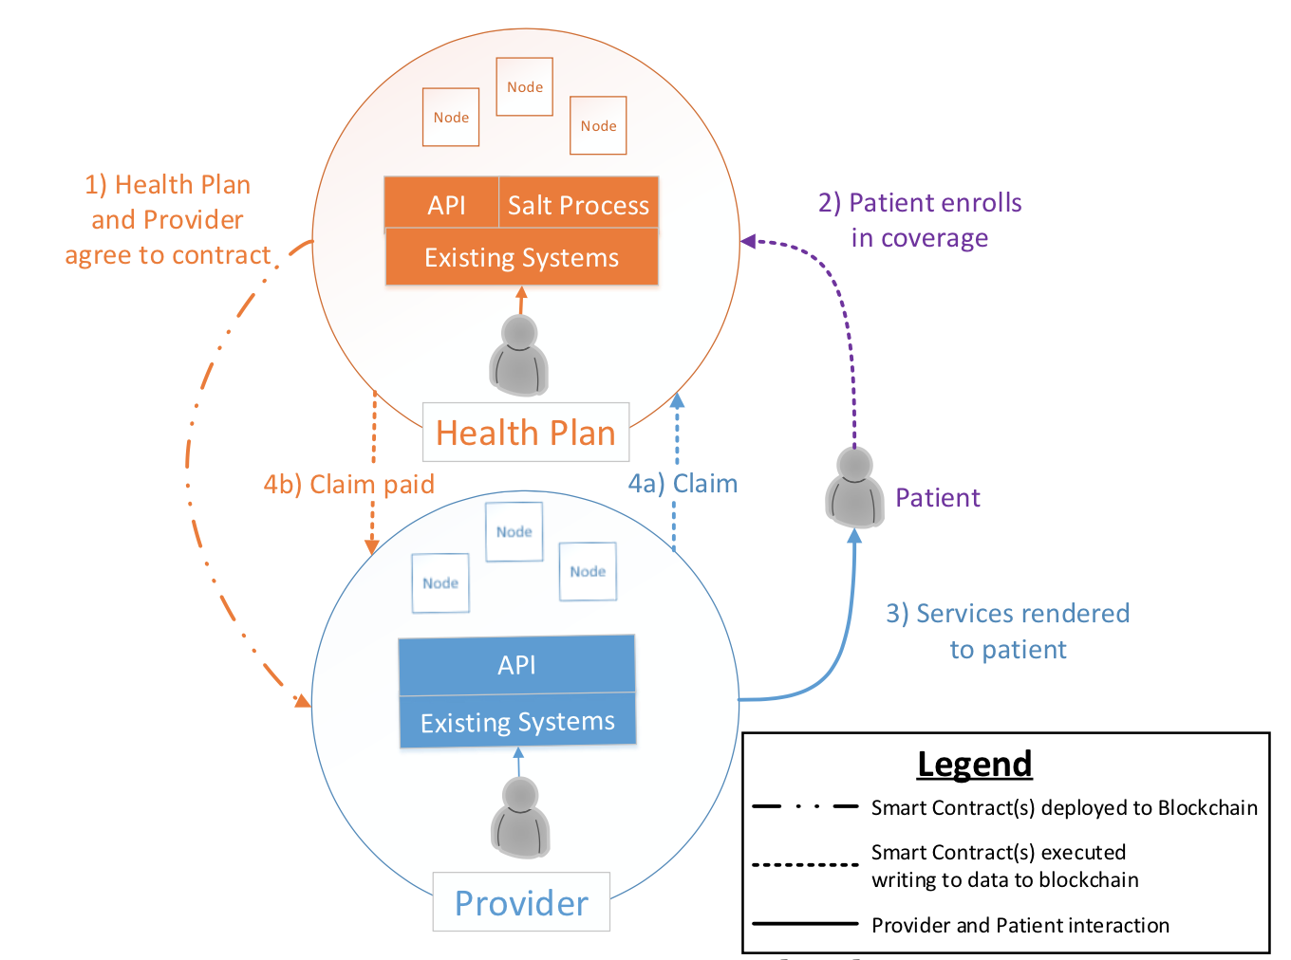
Whitepaper Discussing How The Claims Process Can Be Improved
Blockchain: Private
Content Stored on Chain:
Smart Contracts define the payment terms and agreements made between payers and provider organizations. Claims are processed against patient ID hashes (Payer ID + Member ID + MRN + DOB + Fname + Lname) and results are also stored on the chain. FHIR resource made available for claim supporting data
Rewards for Participation: Fee paid to “miners”.
Notable Findings: Regulators can help define contracts and ensure contracts adhere to regulations. Researchers can leverage claims data as well, paying fees for processing info.
Source: ONC/CCC Use of Blockchain in Health IT and Health-Related Research Challenge (2016)
Blockchain Technologies: A whitepaper discussing how claims process can be improved, Kyle Culver

Slide 29
A Case Study for Blockchain in Healthcare: ”MedRec”
Author: MIT Media Lab, Beth Israel Deaconess Medical Center
Problem Domain: Distributed Consent, Record Locator Service
Solution: Use Blockchain to store PPR and encounter info to create a “patient history” on the chain, and act as a notification directory by determining the list of people that have touched a patient.
Target Industry: Care organizations
Primary Participants: Providers, Patients, Researchers
Source: ONC/CCC Use of Blockchain in Health IT and Health-Related Research Challenge (2016)
A Case Study for Blockchain in Healthcare:“MedRec” prototype for electronic health records and medical research data, Ariel Ekblaw, et al

Slide 30
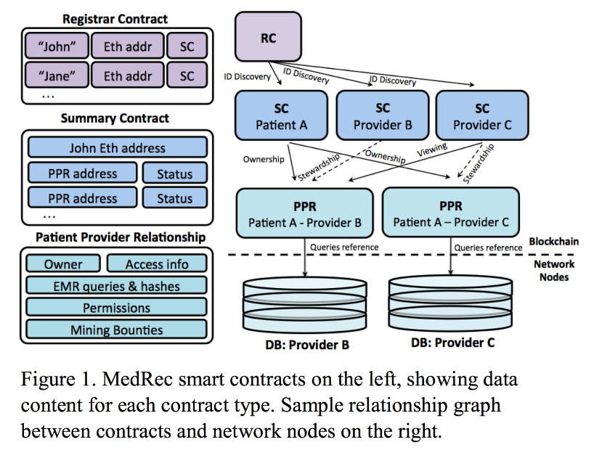
A Case Study for Blockchain in Healthcare: ”MedRec”
Blockchain: Ethereum
Content Stored on Chain: Registration Contract (MRN to Ethereum address mapping, Patient-Provider Contract (PPC) - hash of a subset of clinical data contained at provider, along with provider endpoint info, Summary Contract (SC)
Rewards for Participation: Clinical Research orgs provide compute, and can submit queries as reward mechanisms to participating organizations (eg. “Give me a count of patients currently taking XYX medications”)
Notable Findings: This is actually in pilot today
Source: ONC/CCC Use of Blockchain in Health IT and Health-Related Research Challenge (2016)
A Case Study for Blockchain in Healthcare:“MedRec” prototype for electronic health records and medical research data, Ariel Ekblaw, et al

Slide 31
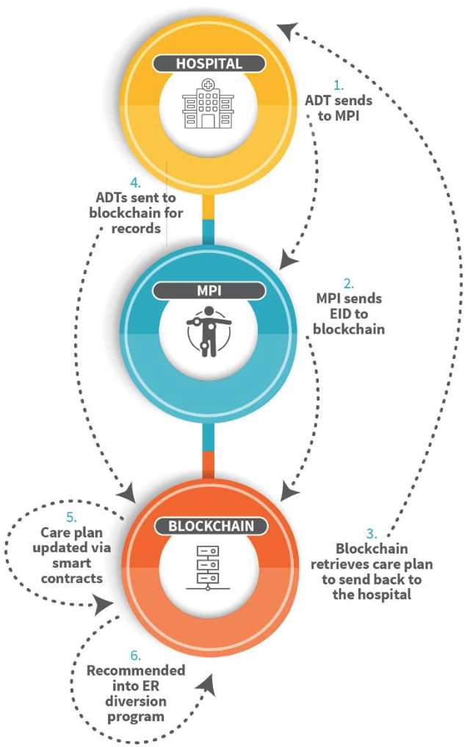
A Case Study for Blockchain in Healthcare: ”MedRec”
Blockchain: Ethereum
Content Stored on Chain: Care plans criteria and algorithms are defined as Smart Contracts on the chain. The chain is notified of ADT events which help determine a patient’s current care plan, also stored on the chain
Rewards for Participation: Fees based on Ethereum structure, funded by ACO
Notable Findings: Paper outlined several areas where Blockchain could be applicable. Described tech as “evolutionary” instead of ”revolutionary”
Source: ONC/CCC Use of Blockchain in Health IT and Health-Related Research Challenge (2016)
A Case Study for Blockchain in Healthcare:“MedRec” prototype for electronic health records and medical research data, Ariel Ekblaw, et al

Slide 32
Blockchain & Alternative Payment Models
Author: King Yip
Problem Domain: ACO – specifically around applicability of Blockchain to creating distributed Care Plans
Solution: Use Blockchain to receive ADT notifications that drive changes to Care Plans, implemented as Smart Contracts. These Smart Contracts change and update based on event inputs, and are distributed amongst the participants in the ACO.
Target Industry: ACOs
Primary Participants: Participant Orgs within an ACO

Slide 33
Summary Results

Slide 34
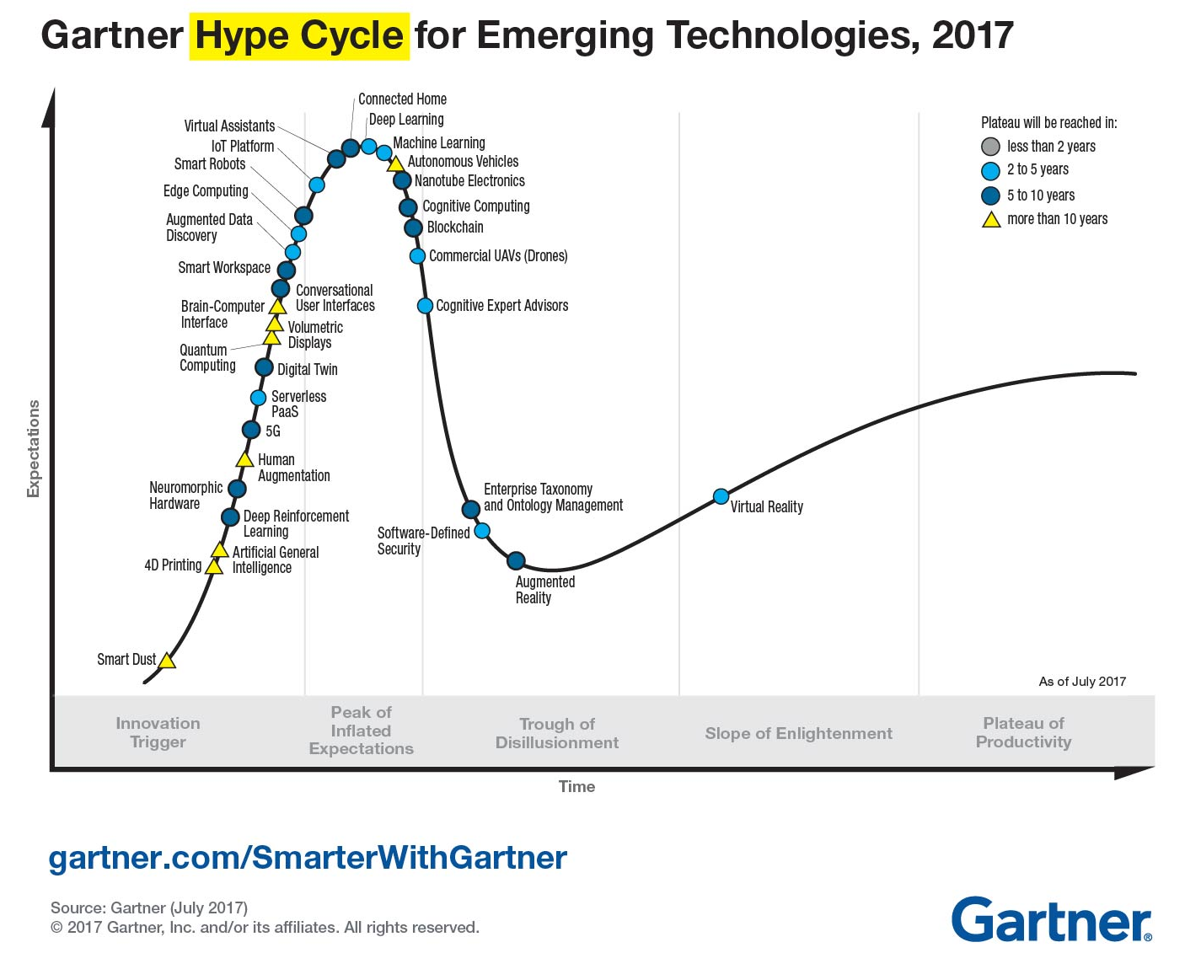
Challenges Ahead – Hype vs Value

Slide 35
Challenges Ahead
Technology that has a lot of potential, but barriers to mass-scale adoption
Technology: distributed solutions
Privacy: maintaining privacy and trust in an open framework
Funding/Business: how do you incent participants?
Inertia: uprooting large, legacy systems and business models

Slide 36
End Results
At the end of Plug-A-Thon, it was apparent that Blockchain was an exciting, but still emerging technology, with areas of interest focused on:
Distributed consent/authorization
Record location services
Alternative incentive models
We’ll find the most success in emerging areas of Health IT (like Alt-Payment Models/ACOs) most open to new technologies

Slide 37
Questions?

