Slide 1
HL7 & IHE: Paving a Better Path to Interoperability

Slide 2
HL7 & IHE: Paving a Better Path to Interoperability
Joyce Sensmeier, MS, RN-BC, CPHIMS, FHIMSS, FAAN,
Vice President, Informatics, HIMSS
Wayne Kubick, MBA
Chief Technology Officer, HL7

Slide 3
Common Vision
A world in which everyone can securely access and use the right health data when and where they need it.
Enable seamless and secure access to health information that is usable whenever and wherever needed.

Slide 4
Common Mission
To provide standards that empower global health data interoperability.
IHE improves healthcare by providing specifications, tools and services for interoperability. IHE engages clinicians, health authorities, industry, and users to develop, test, and implement standards-based solutions to vital health information needs.

Slide 5
Domains and Technical/Planning Committees
Conformity Assessment processes and tools
3 Annual Connectathons (USA, Europe, Asia)
Coordinates use of standards such as HL7 and DICOM for specific needs
IHE national deployment committees in 17 countries
Work groups and Steering Committees
Conformance statements for HL7 Standards
3 Annual FHIR Connectathons (preceding HL7 Working Group Meetings)
Develops standards that are often used in IHE profiles (with DICOM, X.12 . . .)
HL7 Affiliates in 55 countries
Both conduct “testing, education, outreach, collaboration with local health agencies”

Slide 6
IHE Profile Development: A Proven 1-year Quality Management Cycle
Notes:
Each domain follows its own development schedule, some are aligned (ITI, PCC, QRPH)

Slide 7
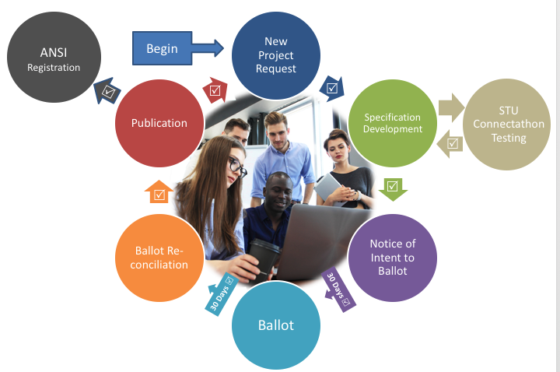
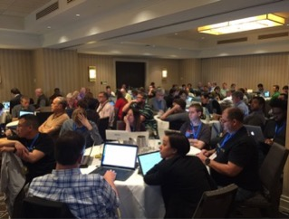
HL7 ANSI-Accredited Standards Process
HL7 work groups meet via conference call and at annual Working Group Meetings (WGMs)
All meetings are open, run under Robert’s rules, with minutes available
STUs and Connectathons allow for ongoing testing by implementers
ANSI rules govern openness, transparency, balance of interests, due process, appeals.

Slide 8
Profiles
IHE creates and maintains implementation guidelines called IHE Profiles, which are published in a set of documents called the IHE Technical Frameworks. IHE Profiles provide a common language for purchasers and vendors to discuss the integration needs of healthcare sites and the integration capabilities of healthcare IT products
HL7 FHIR Profiles define a group of StructureDefinitions (Constraints or Extensions), Value Sets, and examples associated with a FHIR resource for a specific problem or use case
A FHIR Implementation Guide is a set of rules about how FHIR resources are to be used to solve a specific problem
HL7 EHR Functional Profiles define functional requirements for use cases such as Behavioral Health, Child Health, Long term care . . .

Slide 9
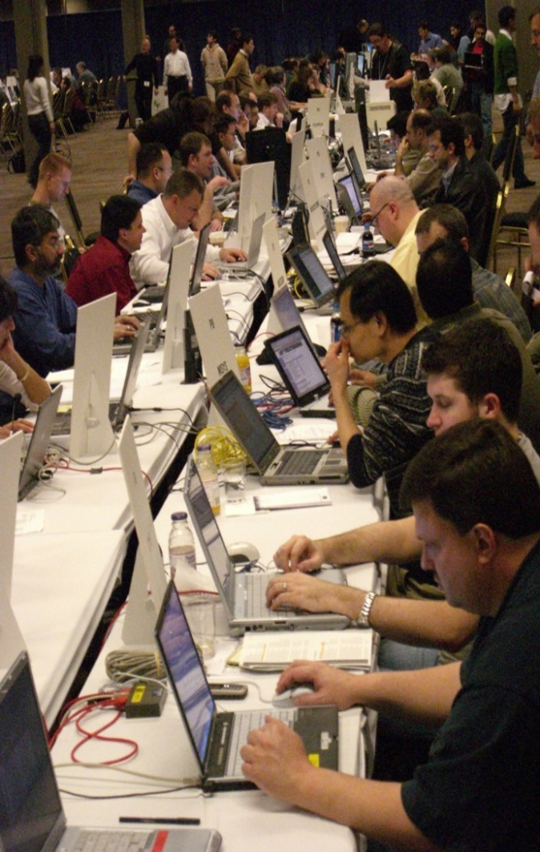
What is a Connectathon?
Cross-vendor, live, supervised, structured testing event
All participating vendors’ products tested together in the same place/time
Experts from each vendor available for immediate problem resolution… fixes are done in minutes, not months!!
Each vendor tests with multiple trading partners (actual product to actual product)
Testing of real-world clinical scenarios

Slide 10
Connectathons
HL7 FHIR Connectathons help implementers assess, test and explore new opportunities for applying the FHIR specification.
Testing as part of a connectathon is a pre-requisite for progressing resources and implementation guides up the FHIR Maturity Model
IHE Connectathons provide a detailed implementation and testing process to enable standards-based interoperability.
Here systems exchange information in a structured and supervised peer-to-peer testing environment, performing transactions required for the roles that perform in carefully defined interoperability use cases (profiles).

Slide 11
IHE Profiles on FHIR
IT Infrastructure (ITI) domain
Mobile access to Health Documents (MHD) a profile on DocumentReference and DocumentManifest to provide a HTTP REST and Mobile application friendly API for the use ases profiled in XDS, XDR, and XCA. The MHD profile may be used as an API to these Document Sharing infrastructures, or may be used alone.
Patient Demographics Query for Mobile (PDQm) a profile of the FHIR Patient resource for simple lookup and reference. Following the functionality requirements profiled in PDQ (HL7 v2), and PDQv3 (HL7 v3)
Patient Identifier Cross-reference for Mobile (PIXm) an operation profile for retrieving just cross-referenced identifiers for a given patient
RESTful Query to ATNA a profile on AuditEvent for query and reporting.
Mobile Alert Communication Management (mACM) a profile on Communication for alert notifications
Mobile Care Services Discovery (mCSD) provides a RESTful interface to discover Care Services: Organization, Location, Practitioner, and Health Services
Mobile Cross-Enterprise Document Data Element Extraction (mXDE) accesses data elements extracted from shared structured documents
Non-patient File Sharing (NPFSm) provides a RESTful interface enable sharing of non-patient files such as clinical workflow definitions, domain policies, and stylesheets
Notes:
An IHE Profile is equivalent to a FHIR Implementation Guide. They take a specific use-case, define actors, define transactions and define Options.

Slide 12
IHE Profiles on FHIR
Patient Care Coordination (PCC) domain
Patient Care Coordination profiles are published on the IHE Technical Framework, and described on the IHE wiki. Clinical Mapping (CMAP) supports mapping to and from clinical terminologies
Guideline Appropriate Ordering (GAO) Supplies a mechanism by which EHR and departmental systems can evaluate orders to determine whether these orders conform to guidelines.
Reconciliation of Clinical Content and Care Providers (RECON) Provides the ability to communicate lists of clinical data that were reconciled, when they were reconciled and who did the reconciliation using CDA® constructs and FHIR® Resource attributes
Dynamic Care Planning (DCP) Profile provides the structures and transactions for care planning, sharing Care Plans that meet the needs of many, such as providers, patients and payers.
Dynamic Care Team Management shares information about a patient's care teams
Query for Existing Data for Mobile (mQED) queries for clinical data elements, including observations, allergy and intolerances, conditions, diagnostic results, medications, immunizations, procedures, encounters and provenance

Slide 13
IHE Profiles on FHIR
Radiology Imaging (RAD) domain
Radiology Imaging profiles are published on the IHE Technical Framework, and described on the IHE wiki. Standardized Operational Log of Events (SOLE) stores and retrieves logs of operational events (patient arrives, scan complete, etc)
Quality, Research, and Public Health (QRPH) domain
Mobile Retrieve Form for Data Capture (mRFD) describes the exchange of context data to allow a seamless form launch with supporting clinical context
Vital Records Death Reporting (VRDR) defines a Retrieve Form for Data Capture (RFD) content profile that will specify derivation of source content from a medical summary document. by defining requirements for form filler content and form manager handling of the content

Slide 14
IHE on FHIR Connectathon Tracks
To support testing at HL7 & IHE Connectathons on the IHE Profiles that leverage HL7 FHIR.
201801 Care Plan
IHE Dynamic Care Planning Profile
201801 Medical Device and Implantables Tracking using UDI
IHE Point-of-Care Medical Device Tracking Profile
201801 Provider Directory
IHE Mobile Care Services Discovery (mCSD) Profile
201801 Patient Track
IHE Patient Demographics for Mobile (PDQm) Profile
Devices on FHIR® IHE Plugathon

Slide 15
IHE January Plug-a-thon Example
IHE Document: Draft for Discussion only

Slide 16
Joint HL7-IHE Cancer Staging Project
Purpose: to demonstrate how the combined efforts of IHE, HL7 and HIMSS can add value to advance interoperability
Goal: seek to make incremental progress over the course of IHE and HL7 Connectathons to develop an interoperability solution built on FHIR and profiles, culminating in a joint publication in 2018
2 breast cancer storyboards involving pathology, imaging, treatment and other electronic health data
Primary HL7 work groups participating include Health Care Devices, Image Integration and CIMI
Primary IHE domain is Patient Care Coordination.

Slide 17
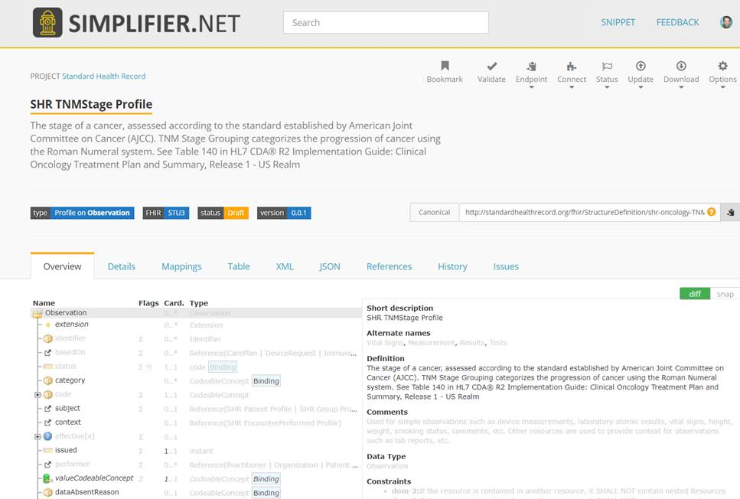

Slide 18
Technical Objectives of Collaboration
Learn how to integrate FHIR test scripts and tools with IHE Gazelle test management system and tools
Build awareness within IHE on how to publish implementation guides through the FHIR IG Publisher
Engage HL7 work groups who might benefit from IHE experience in conformance testing and validation services, specifically terminology services and the FHIR Patient Track
Expose IHE to HL7 FHIR terminology services and value set tooling to support other IHE profiles.

Slide 19
Industry Objectives of Collaboration
More rapidly advance interoperability by sharing knowledge and expertise
Build on decades of standards development experience to inform innovation
Break down silos and align work, minimize duplication where feasible
Demonstrate the importance of standards in enabling interoperability and build the bridge to improved quality and outcomes

Slide 20
Conclusions
Interoperability by definition needs all affected parties to work together if it is ever to become a feasible reality
Committing to the interoperability vision thus involves placing the common good above that of any single individual or organization
HL7 and IHE, with the support of HIMSS, can make a significant difference in achieving the vision by sharing the best of all worlds
We’re only beginning to realize what we can do – stay tuned for more progress updates as our collaboration continues.

Slide 21
HL7 & IHE: Paving a Better Path to Interoperability
Questions?

